Slide 1
DKG trips with Go Ahead Tours! England, Scotland, & ireland, 2016 Spain and Portugal, 2017
By Merry Lewis and Marge Threewit, Arizona

Slide 2
Buckingham Palace in England The Flag up, says the queen is in!

Slide 3
sir walter scott’s home Abbotsford in Scotland. What an eclectic collection he gathered in his home. How exciting to see where he sat to write his books!

Slide 4
Marge with Group having the “time of our lives”! Beautiful Killarney Castle in Ireland

Slide 5
Merry and Marge after Carriage Ride around Killarney Castle. Wow! What fun!

Slide 6
DkG members enjoying lunch and Fellowship at The circle of kerry, ireland

Slide 7
Now on to Portugal and Spain! You can meet anyone on these trips, even the next International President, Cathy Daugherty! She’s standing next to Merry!

Slide 8
Lisbon had something for everyone . . . music, food and beautiful statues.

Slide 9
In Sevilla, Spanish Plaza, El Alcazar, Palace of Don Pedro
“Every stop offers a Kodak moment and picture taking is definitely part of the tour.”

Slide 10
Merry enjoying the view of the Cliff-top Imperial City of toledo, Spain.

Slide 11
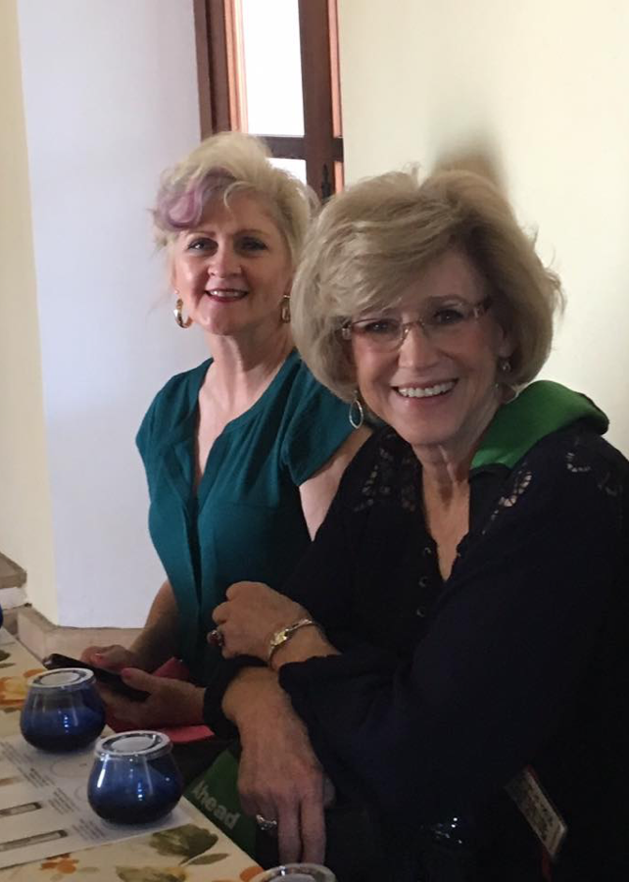
Learning about olives with Beverlly helms, Past international president

Slide 12
What better way to meet, get to know dkg members, and see the world? DKG Go Ahead tours!

